Slide 1
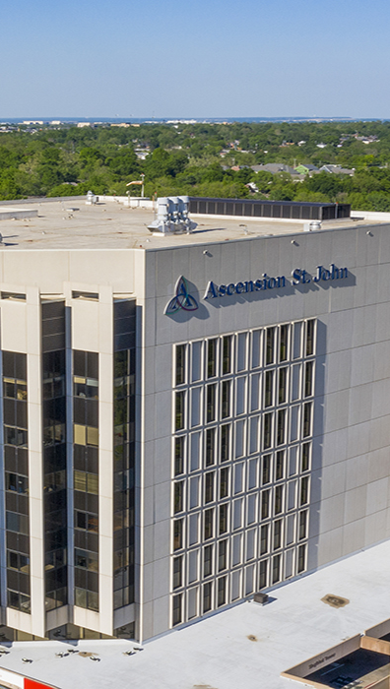

OPPORTUNITY REVIEW
DIRECT-TO-EMPLOYER GTM STRATEGY
Exploring an Ascension Health OK DTE Health Plan

Slide 2


Founded in 1979, headquartered in Indianapolis
Largest Independently-Owned Full-Service Third-Party Administrator
Specialize in Administration of Self-Funded Plans and Population Health Management​
Leader in the Direct-to-Employer Movement
We Know and Understand the Market
Experience Working with All Professional Teams: Agents, Networks, MGAs
The Key Family of Companies is a Vertically Integrated group of benefit related organizations
3,000+ Corporate Clients
3 Million Members under Management
700 Employees

Slide 3


MARKET LEADER
IN
PRIVATE LABELED
DTE PLANS
Louisville, KY
OneHealth Plan
Cincinnati, OH
TCH Optimal
Bentonville, AR
Northwest Health Plan
Knoxville, TN
East Tennessee Health Plan
Meridian, MS
Affinity Health Plan
Fort Myers, FL
Lee Health Care Partners

Slide 4


CASH BACK BENEFITS KEEPS ASCENSION EMPLOYEES
AT ASCENSION
What Will this Claim Cost Me?
Ascension employees will often receive cash, not bills when they choose to seek care within Ascension Health, creating millions in plan savings.
Notes:
Make necessary changes to match slide 4 of updated ppt provided by Jan

Slide 5

Direct-to-Employer Strategy: POWERFUL EMPLOYER AND HEALTH SYSTEM VALUE
KBA’s unique approach builds plans with even-to-commercial provider reimbursement paired with highly competitive rates for employers.
DTE partners see high within-plan steerage to their providers and facilities, generating a powerful ROI.
KBA models plan growth and steerage rates to estimate plan ROI.
PLAN GROWTH
STRONG STEERAGE
FINANCIAL ROI
+
=

Slide 6

THE SCIENCE OF SUCCESSFUL PLAN GROWTH
Brand Reputation
Access
Patient Word of Mouth
Patient Choice Trends
Reputation of Anchor Hospital
Anchor Hospital
Sufficient Market Share
Market
Large Enough Market Size
High Percentage of Self Funding
Over 10 years of experience KBA has learned:
Choosing the right partner health system is critical for plan success and sales

Slide 7
MEASURING BRAND REPUTATION Brand Reputation Ratings for the Tulsa OK Region
Health System | HCAHPS Recommendation Percentile | CMS Stars Percentile | Mortality Percentile | Readmission Percentile | KBA Brand Reputation Score
Saint Francis Health System | 75 | 83 | 72 | 66 | 70
Other Independent Hospitals | 69 | 84 | 69 | 74 | 68
Ascension Health | 49 | 47 | 56 | 75 | 61
Ardent | 51 | 45 | 69 | 81 | 61
Ascension Health’s brand quality in the Tulsa area is strong enough to consider launching a plan in the Tulsa area but would face strong headwinds against Saint Francis Health System.

Slide 8

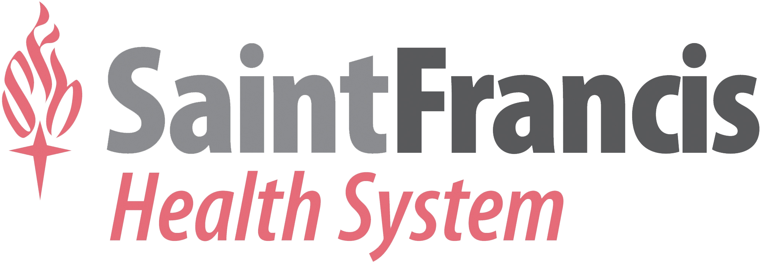
ACCESS AND MARKET SHARE FOR MODELING
Hospital Name | Number of Beds | Inpatient Total Charges | Outpatient Total Charges
Ascension St John Jane Phillips Medical Center | 81 | $ 131,666.6K | $ 324,545.6K
Ascension St John Medical Center | 419 | $1,241,286.2K | $ 722,538.5K
Ascension St John Owasso | 54 | $ 27,562.2K | $ 132,718.9K
Ascension St John Broken Arrow | 62 | $ 42,229.8K | $ 228,142.7K
Ascension St John Nowata | 25 | $ 2,090.6K | $ 8,750.4K
Ascension St John Sapulpa | 25 | $ 11,928.6K | $ 92,051.6K
Saint Francis Hospital Muskogee | 236 | $ 376,699.4K | $ 417,065.5K
Oklahoma State University Medical Center | 119 | $ 332,105.5K | $ 259,364.2K
Saint Francis Hospital | 1,056 | $2,470,145.7K | $2,565,109.7K
Saint Francis Hospital South | 96 | $ 216,573.5K | $ 484,669.3K
Saint Francis Hospital Vinita | 35 | $ 25,003.7K | $ 78,978.8K
Sedan City Hospital | 15 | $ 1,147.8K | $ 5,048.0K
Hillcrest Medical Center | 424 | $2,494,589.5K | $1,820,676.2K
INTEGRIS Miami Hospital | 36 | $ 49,458.5K | $ 155,570.8K
Hillcrest Hospital Pryor | 21 | $ 13,142.3K | $ 151,189.9K
Hillcrest Hospital Claremore | 41 | $ 99,847.8K | $ 355,316.0K
Muscogee Creek Nation Medical Center | 50 | $ 14,874.9K | $ 70,325.4K
Northeastern Health System Tahlequah | 80 | $ 140,559.7K | $ 232,835.6K
INTEGRIS Health Grove Hospital | 41 | $ 64,522.9K | $ 192,948.8K
Wagoner Community Hospital | 100 | $ 18,581.5K | $ 34,313.2K
Cherokee Nation WW Hastings Hospital | 52 | $ NAK | $ NAK
Claremore Indian Hospital | 46 | $ NAK | $ NAK
Hillcrest Hospital South | 152 | $ 574,416.6K | $ 612,398.5K
Oklahoma Surgical Hospital | 74 | $ 93,523.8K | $ 445,252.1K
Tulsa Spine & Specialty Hospital | 38 | $ 93,336.3K | $ 316,388.6K
Bailey Medical Center | 33 | $ 78,301.7K | $ 328,424.4K
Council Oak Comprehensive Health Care | 40 | $ 2,323.4K | $ 10,507.3K
Carrus Lakeside Hospital | 25 | $ 114,680.5K | $ 164,830.1K
Cleveland Area Hospital | 14 | $ 7,683.0K | $ 34,684.3K
17% Inpatient Market Share
7% Outpatient Market Share
38% Inpatient Market Share
17% Outpatient Market Share
For outpatient market share, it is estimated that only 49.1% of local physicians are employed by area hospitals (Research from the Physician Advocacy Institute: https://www.physiciansadvocacyinstitute.org/Portals/0/assets/docs/PAI-Research/PAI-Avalere%20Physician%20Employment%20Trends%20Study%202019-2023%20Final.pdf?ver=uGHF46u1GSeZgYXMKFyYvw%3d%3d)

Slide 9
ASCENSION OKLAHOMA STAND ALONE PLAN
Plan size and growth modeled for an Ascension Health plan with
Saint Francis Health System passively included

Slide 10
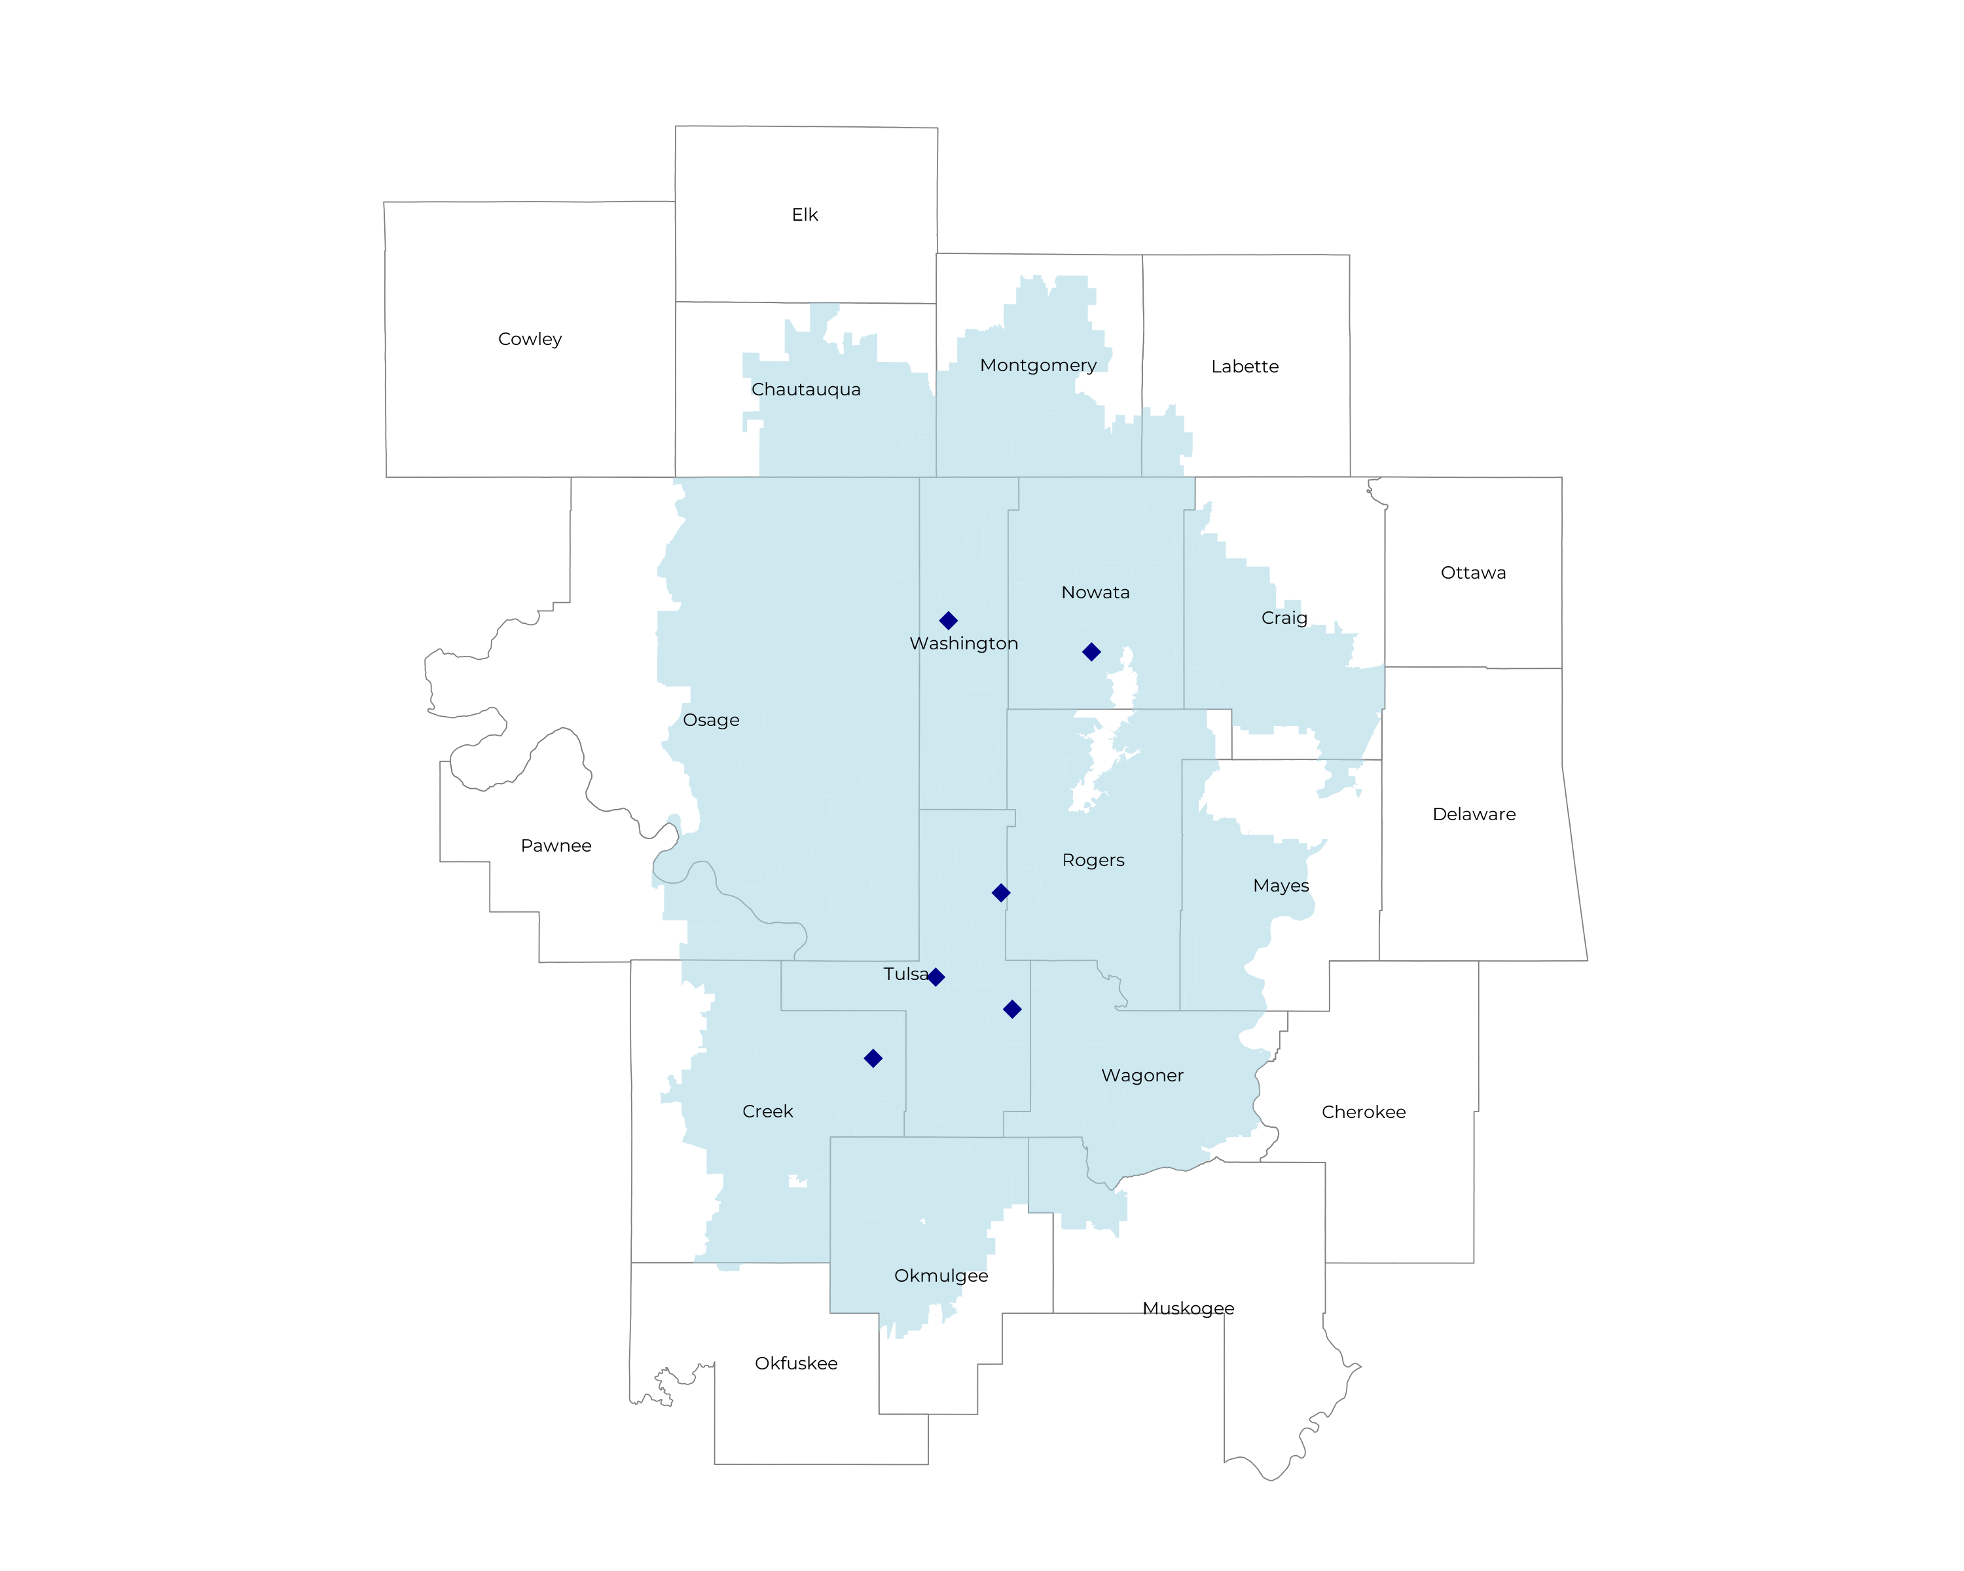
MEASURING STANDALONE MARKET SIZE
Self Funded
228K
Insured
413K
Working Age
629K
Population
1,091K

Slide 11
PROJECTED PLAN GROWTH
Year | Employees | Members | Percent of Members Choosing Ascension for Inpatient Care | Percent of Members Choosing Ascension for Outpatient Care
1 | 300 | 500 | 60% | 50%
2 | 600 | 1,100 | 60% | 50%
3 | 1,000 | 1,800 | 65% | 55%
4 | 1,500 | 2,700 | 67% | 58%
5 | 2,200 | 4,000 | 68% | 60%
6 | 3,000 | 5,400 | 68% | 60%
7 | 4,000 | 7,200 | 69% | 61%
8 | 5,100 | 9,200 | 69% | 62%
9 | 6,400 | 11,500 | 69% | 62%
10 | 7,800 | 14,000 | 70% | 63%
11 | 9,200 | 16,600 | 70% | 63%
12 | 10,600 | 19,100 | 70% | 64%
13 | 11,900 | 21,400 | 71% | 64%
14 | 13,100 | 23,600 | 71% | 65%
15 | 14,000 | 25,200 | 71% | 66%
16 | 14,800 | 26,600 | 72% | 66%
17 | 15,500 | 27,900 | 72% | 66%
18 | 16,000 | 28,800 | 72% | 67%
19 | 16,400 | 29,500 | 72% | 67%
20 | 16,600 | 29,900 | 72% | 67%
In most commercial plans in the Tulsa area, Ascension receives ~17% of inpatient market share and ~7% of outpatient market share. This plan would have a far higher percentage of patients choosing Ascension Health.
Plan growth is muted because of Saint Francis’s strong brand.
KBA conservatively models steerage growth based on past DTE-plan experience.

Slide 12
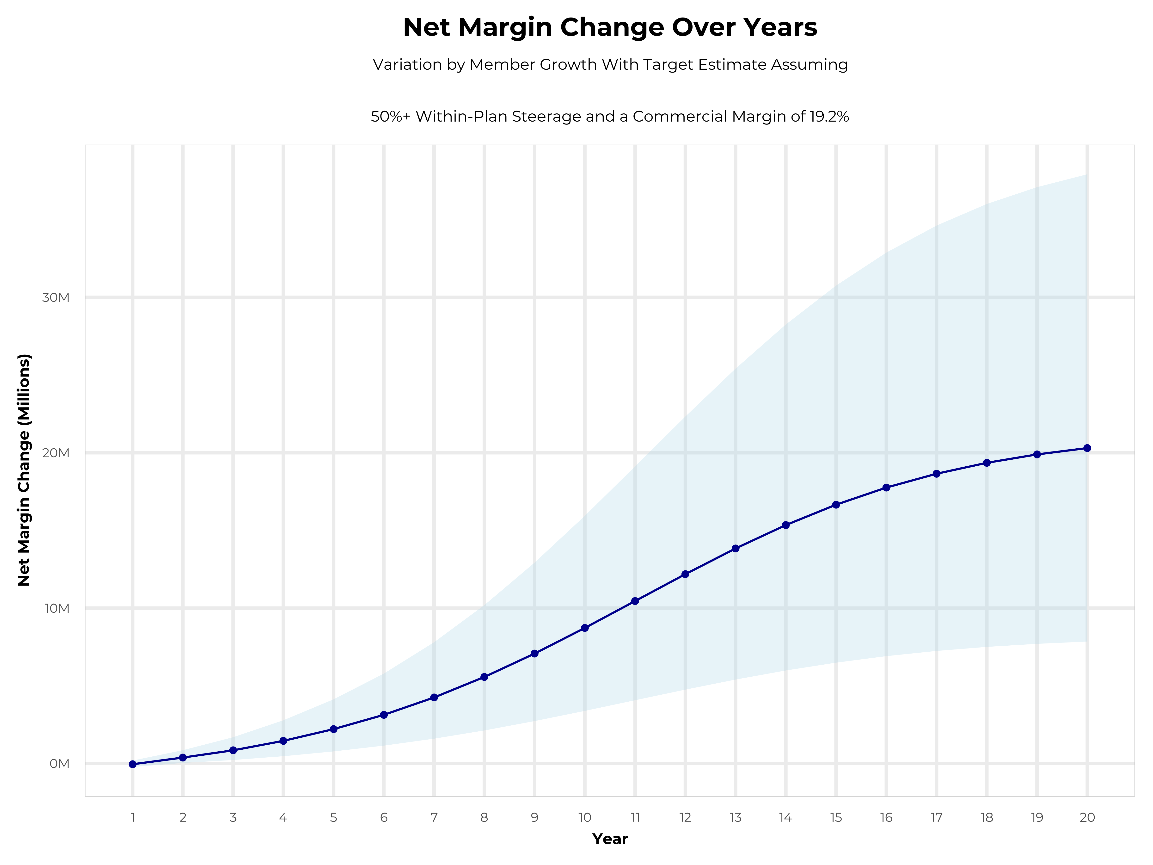
GROWING POWERFUL, LASTING PROFITABILITY
Early Stage
Gaining Name Recognition, Early Growth
New Revenue:
New Profit:
$7.81M
$1.33M
Growth Stage
Strong Reputation, Strong Growth
New Revenue:
New Profit:
$46.16M
$8.87M
Mature Stage
High Profitability, Market Saturation
New Revenue:
New Profit:
$94.24M
$18.28M

Slide 13
YEAR 4 PROJECTED REVENUE AND PROFIT
Pre-DTE Cohort of 2,800 Employees | Inpatient | Outpatient | Professional | Total
Revenue† | $ 1,488,861 | $ 1,206,869 | $ 563,597.5 | $ 3,259,328
Net Income‡ | $ 285,861.3 | $ 231,718.8 | $ 108,210.7 | $ 625,790.9
† Assuming proportional revenues from market shares of 18% (inpatient) and 8% (outpatient)
‡ Conservatively assuming a commercial margin of 19.2% (80% of the estimated commercial margin)
With DTE | Inpatient | Outpatient | Professional | Total
Revenue⁰ | $ 5,563,155 | $ 8,727,663 | $ 4,075,745 | $ 18,366,563
Net Income* | $ 1,068,126 | $ 1,675,711 | $ 782,543 | $ 3,526,380
⁰ Assuming 67% inpatient and 58% market steerage based on KBA narrow network DTE experience
* Conservatively assuming a commercial margin of 19.2%, with a 10 percentage-point reduction to reflect competitive-edge rates and a 10 percentage-point increase due to lower billing costs and higher patient responsibility collections because of the member credit card.
Total Increase in Net Income | $ 2,900,589
Network Access Fee (Revenue) of $1 PMPM | $ 33,600
Total Profit Growth | $ 2,905,389
Minus Implementation Fee (One-Time) | -$ 0
Minus Sales and Marketing (Annual – Ongoing) | -$ 180,000
Total | $ 2,754,189

Slide 14
ASCENSION OKLAHOMA PARTNERED PLAN
Plan size and growth modeled in active partnership with Saint Francis Health System

Slide 15
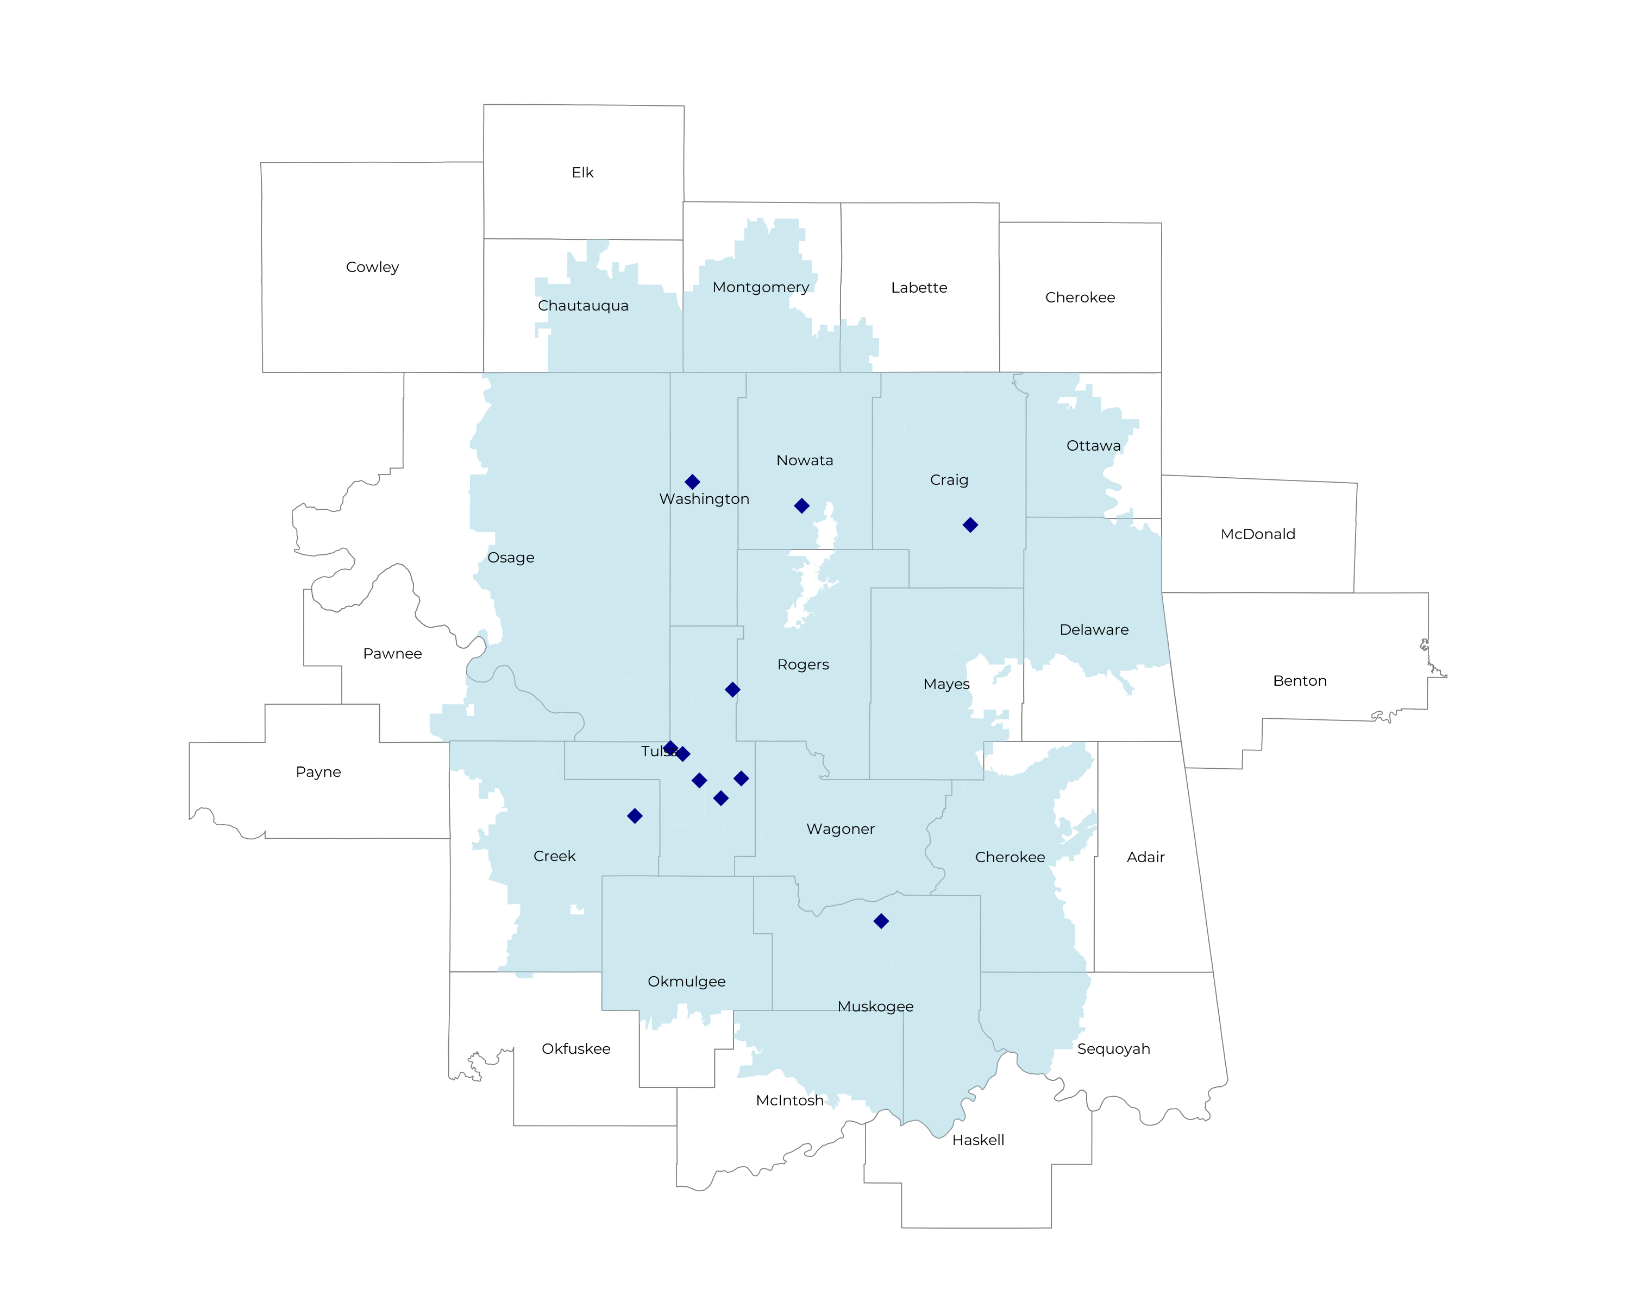
MEASURING PARTNERED MARKET SIZE
Self Funded
262K
Insured
474K
Working Age
743K
Population
1,298K
Partnered market size is larger than standalone as Saint Francis’s facilities increase reach.

Slide 16
STRONGER FORECASTED PLAN GROWTH
Year | Employees | Members | Percent of Members Choosing Ascension for Inpatient Care | Percent of Members Choosing Ascension for Outpatient Care
1 | 1,100 | 2,000 | 28% | 28%
2 | 2,100 | 3,800 | 28% | 28%
3 | 3,500 | 6,300 | 28% | 28%
4 | 5,300 | 9,500 | 28% | 28%
5 | 7,600 | 13,700 | 28% | 28%
6 | 10,400 | 18,700 | 28% | 28%
7 | 13,700 | 24,700 | 28% | 28%
8 | 17,600 | 31,700 | 28% | 28%
9 | 22,100 | 39,800 | 28% | 28%
10 | 26,800 | 48,200 | 28% | 28%
11 | 31,700 | 57,100 | 28% | 28%
12 | 36,500 | 65,700 | 28% | 28%
13 | 41,000 | 73,800 | 28% | 28%
14 | 45,000 | 81,000 | 28% | 28%
15 | 48,400 | 87,100 | 28% | 28%
16 | 51,200 | 92,200 | 28% | 28%
17 | 53,400 | 96,100 | 28% | 28%
18 | 55,100 | 99,200 | 28% | 28%
19 | 56,400 | 101,500 | 28% | 28%
20 | 57,300 | 103,100 | 28% | 28%
In most commercial plans in the Tulsa area, Ascension receives ~17% of inpatient market share and ~7% of outpatient market share. This plan would have a far higher percentage of patients choosing Ascension Health.
KBA conservatively models steerage growth based on past DTE-plan experience, assuming Ascension receives 31% of steered care.
Plan growth is far stronger in a partnered health plan.

Slide 17
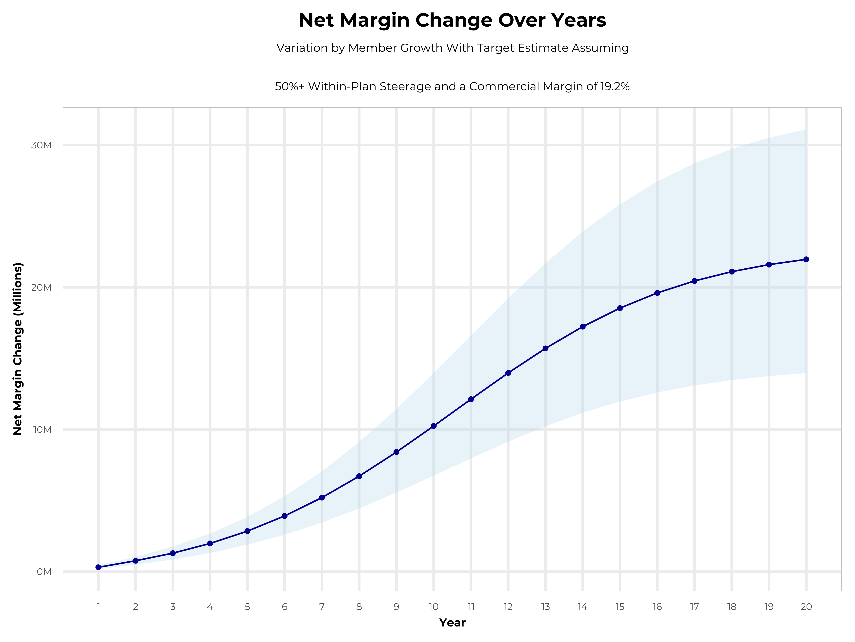
STRONGER PROFITABILITY THROUGH PARTNERSHIP
Early Stage
Gaining Name Recognition, Early Growth
New Revenue:
New Profit:
$9.87M
$1.86M
Growth Stage
Strong Reputation, Strong Growth
New Revenue:
New Profit:
$53.46M
$10.34M
Mature Stage
High Profitability, Market Saturation
New Revenue:
New Profit:
$103.47M
$20.07M

Slide 18
YEAR 4 PROJECTED REVENUE AND PROFIT
Pre-DTE Cohort of 9,600 Employees | Inpatient | Outpatient | Professional | Total
Revenue† | $ 4,735,913 | $ 3,734,572 | $ 1,744,013 | $ 10,214,498
Net Income‡ | $ 909,295.3 | $ 717,037.8 | $ 334,850.6 | $ 1,961,184
† Assuming proportional revenues from market shares of 17% (inpatient) and 7% (outpatient)
‡ Conservatively assuming a commercial margin of 19.2% (80% of the estimated commercial margin)
With DTE | Inpatient | Outpatient | Professional | Total
Revenue⁰ | $ 7,954,238 | $ 14,460,977 | $ 6,753,153 | $ 29,168,368
Net Income* | $ 1,527,214 | $ 2,776,508 | $ 1,296,605 | $ 5,600,327
⁰ Assuming 28% inpatient and 28% market steerage based on KBA narrow network DTE experience.
* Conservatively assuming a commercial margin of 19.2%, with a 10 percentage-point reduction to reflect competitive-edge rates and a 10 percentage-point increase due to lower billing costs and higher patient responsibility collections because of the member credit card.
Total Increase in Net Income | $ 3,639,143
Network Access Fee (Revenue) of $1 PMPM | $ 36,000
Total Profit Growth | $ 3,640,643
Minus Implementation Fee (One-Time) | -$ 0
Minus Sales and Marketing (Annual – Ongoing) | -$ 56,250
Total | $ 3,618,893

Slide 19
ASCENSION TENNESSEE PLAN MODELING
Plan size and growth modeled on a standalone Ascension Health TN Plan

Slide 20
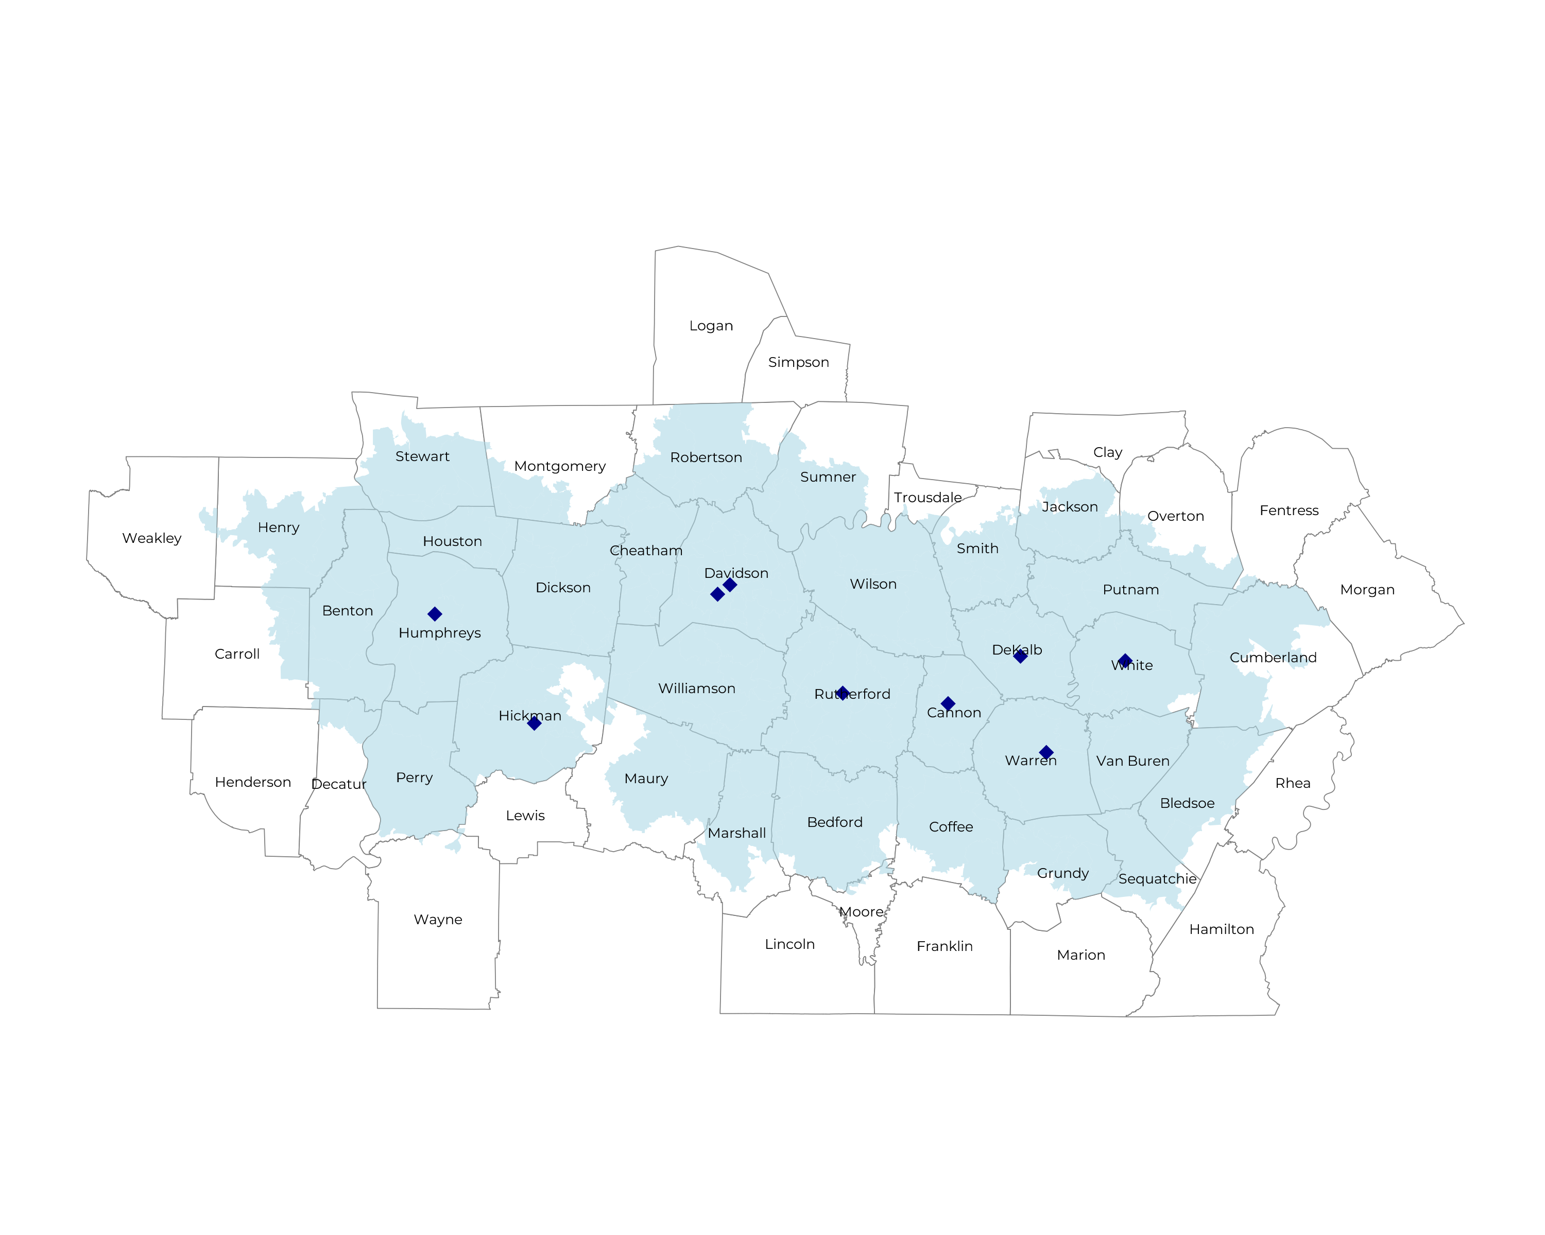
SIGNIFICANT OPPORTUNITY FOR PLAN GROWTH Researched for the below highlighted service area
Self Funded
551K
Insured
1,003K
Working Age
1,388K
Population
2,279K

Slide 21
ASCENSION HEALTH IS EVEN WITH VANDERBILT AND LEADING OTHER HEALTH SYSTEMS IN REPUTATION
Health System | HCAHPS Recommendation Percentile | CMS Stars Percentile | Mortality Percentile | Readmission Percentile | KBA Brand Quality Score
Vanderbilt Health | 78 | 85 | 60 | 79 | 71
Ascension Health | 71 | 54 | 67 | 75 | 69
Other Independent Hospitals | 59 | 87 | 56 | 65 | 67
Maury Regional Health System | 52 | 61 | 73 | 76 | 64
Williamson Health | 55 | 87 | 69 | 92 | 63
HCA Healthcare | 51 | 64 | 82 | 61 | 62
Cookeville Regional Medical Center System | 55 | 10 | 67 | 47 | 62
LifePoint Health | 22 | 24 | 65 | 67 | 50

Slide 22
PROJECTED PLAN GROWTH
Year | Employees | Members | Percent of Members Choosing Ascension Health TN for Inpatient Care | Percent of Members Choosing Ascension Health TN for Outpatient Care
1 | 800 | 1,400 | 70% | 60%
2 | 1,500 | 2,700 | 70% | 60%
3 | 2,500 | 4,500 | 73% | 65%
4 | 3,700 | 6,700 | 74% | 67%
5 | 5,300 | 9,500 | 74% | 68%
6 | 7,300 | 13,100 | 74% | 68%
7 | 9,600 | 17,300 | 74% | 69%
8 | 12,400 | 22,300 | 74% | 69%
9 | 15,500 | 27,900 | 74% | 69%
10 | 18,800 | 33,800 | 75% | 70%
11 | 22,200 | 40,000 | 75% | 70%
12 | 25,600 | 46,100 | 75% | 70%
13 | 28,800 | 51,800 | 75% | 71%
14 | 31,600 | 56,900 | 75% | 71%
15 | 33,900 | 61,000 | 75% | 71%
16 | 35,900 | 64,600 | 75% | 72%
17 | 37,400 | 67,300 | 75% | 72%
18 | 38,600 | 69,500 | 75% | 72%
19 | 39,500 | 71,100 | 75% | 72%
20 | 40,200 | 72,400 | 76% | 72%
KBA currently estimates that Ascension Health TN has 18% inpatient market share, and 7% outpatient market compared to hospitals/clinics in the Ascension Health TN service area.
Based on previous DTE experience, KBA expects a significant bump in patient steerage to Ascension Health TN.
Additional steerage will occur from additional steerage patient benefits and the patient card.

Slide 23
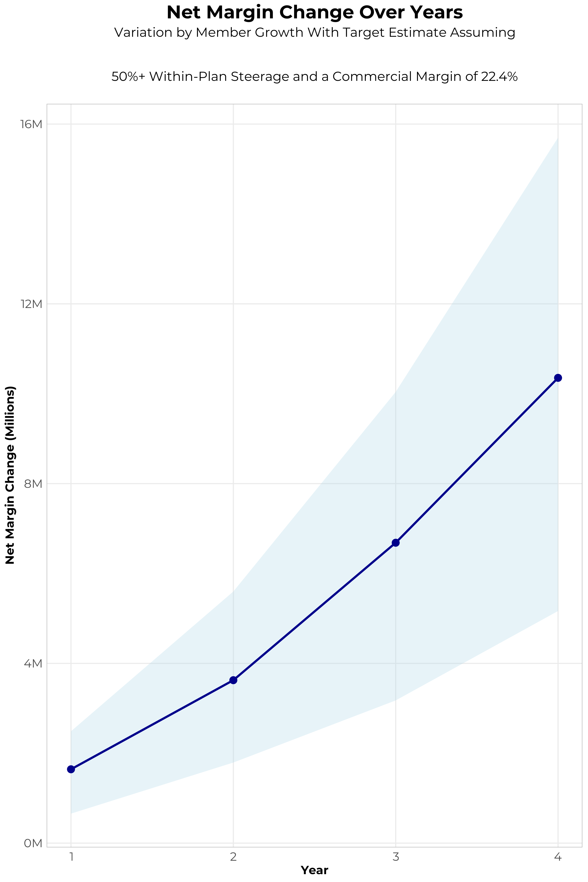
FOUR-YEAR PROJECTIONS
Target Member Growth | Target Member Growth | Target Member Growth | Target Member Growth | Target Member Growth
Metric | Year 1 | Year 2 | Year 3 | Year 4
Number of Members | 1,400 | 2,700 | 4,500 | 6,700
Incremental Margin | 1,956.7K | 3,773.7K | 6,810.5K | 10,453.0K
Network Access Fee | 16.8K | 32.4K | 54.0K | 80.4K
Implementation Fee (One-Time) | -150.0K | 0.0K | 0.0K | 0.0K
Sales and Marketing Costs | -180.0K | -180.0K | -180.0K | -180.0K
Net Margin Change | 1,643.5K | 3,626.1K | 6,684.5K | 10,353.4K
High Member Growth | High Member Growth | High Member Growth | High Member Growth | High Member Growth
Metric | Year 1 | Year 2 | Year 3 | Year 4
Number of Members | 2,000 | 4,100 | 6,700 | 10,100
Incremental Margin | 2,795.3K | 5,730.4K | 10,140.1K | 15,757.5K
Network Access Fee | 24.0K | 49.2K | 80.4K | 121.2K
Implementation Fee (One-Time) | -150.0K | 0.0K | 0.0K | 0.0K
Sales and Marketing Costs | -180.0K | -180.0K | -180.0K | -180.0K
Net Margin Change | 2,489.3K | 5,599.6K | 10,040.5K | 15,698.7K
Low Member Growth | Low Member Growth | Low Member Growth | Low Member Growth | Low Member Growth
Metric | Year 1 | Year 2 | Year 3 | Year 4
Number of Members | 700 | 1,400 | 2,200 | 3,400
Incremental Margin | 978.4K | 1,956.7K | 3,329.6K | 5,304.5K
Network Access Fee | 8.4K | 16.8K | 26.4K | 40.8K
Implementation Fee (One-Time) | -150.0K | 0.0K | 0.0K | 0.0K
Sales and Marketing Costs | -180.0K | -180.0K | -180.0K | -180.0K
Net Margin Change | 656.8K | 1,793.5K | 3,176.0K | 5,165.3K

Slide 24
YEAR 4 PROJECTED REVENUE AND PROFIT
Pre-DTE Cohort of 6,700 Employees | Inpatient | Outpatient | Professional | Total
Revenue† | $ 3,855,895 | $ 2,726,150 | $ 1,273,089 | $ 7,855,135
Net Income‡ | $ 863,720.5 | $ 610,657.7 | $ 285,171.9 | $ 1,759,550
† Assuming proportional revenues from market shares of 18% (inpatient) and 7% (outpatient)
‡ Conservatively assuming a commercial margin of 22.4% (80% of the estimated commercial margin)
With DTE | Inpatient | Outpatient | Professional | Total
Revenue⁰ | $ 15,797,669 | $ 26,151,326 | $ 12,212,447 | $ 54,161,442
Net Income* | $ 3,538,678 | $ 5,857,897 | $ 2,735,588 | $ 12,132,163
⁰ Assuming 74% inpatient and 67% market steerage based on KBA narrow network DTE experience (see previous slide)
* Conservatively assuming a commercial margin of 22.4%, with a 10 percentage-point reduction to reflect competitive-edge rates and a 10 percentage-point increase due to lower billing costs and higher patient responsibility collections because of the member credit card.
Total Increase in Net Income | $ 10,372,613
Network Access Fee (Revenue) of $1 PMPM | $ 80,400
Total Profit Growth | $ 10,377,413
Minus Implementation Fee (One-Time) | -$ 0
Minus Sales and Marketing (Annual – Ongoing) | -$ 180,000
Total | $ 10,273,013

Slide 25
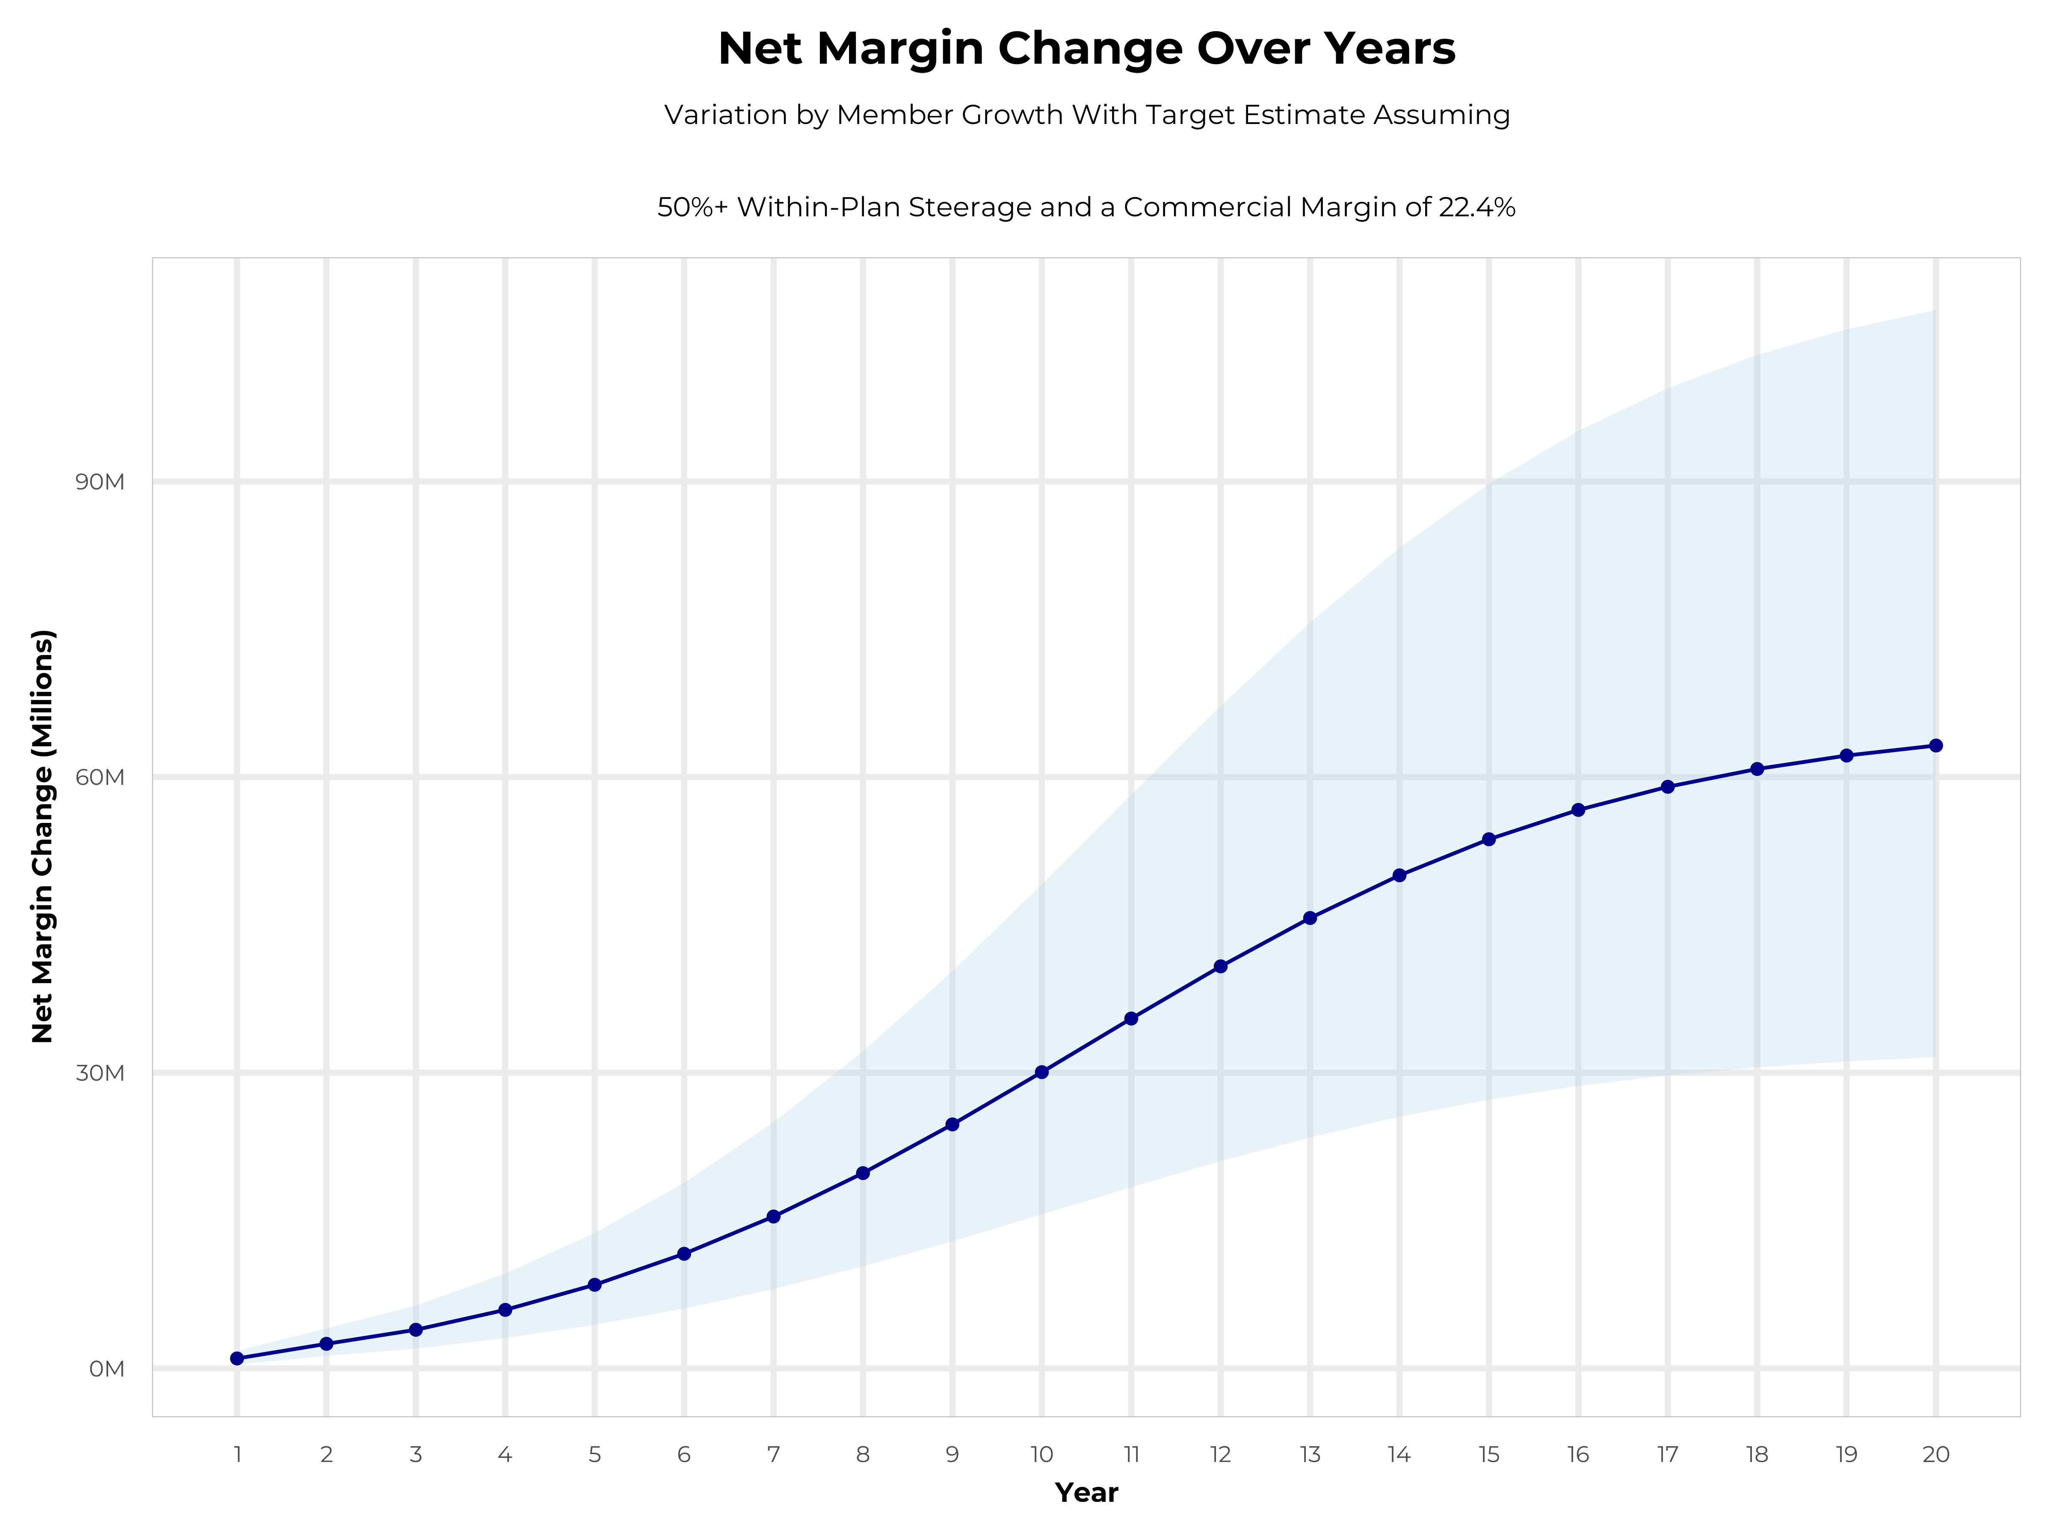
GROWING POWERFUL, LASTING PROFITABILITY
Early Stage
Gaining Name Recognition, Early Growth
New Revenue:
New Profit:
$24.59M
$5.57M
Growth Stage
Strong Reputation, Strong Growth
New Revenue:
New Profit:
$129.47M
$30.29M
Mature Stage
High Profitability, Market Saturation
New Revenue:
New Profit:
$246.81M
$57.95M

Slide 26
PARTNERED ASCENSION TENNESSEE PLAN MODELING
Plan size and growth modeled on a partnership with Vanderbilt

Slide 27
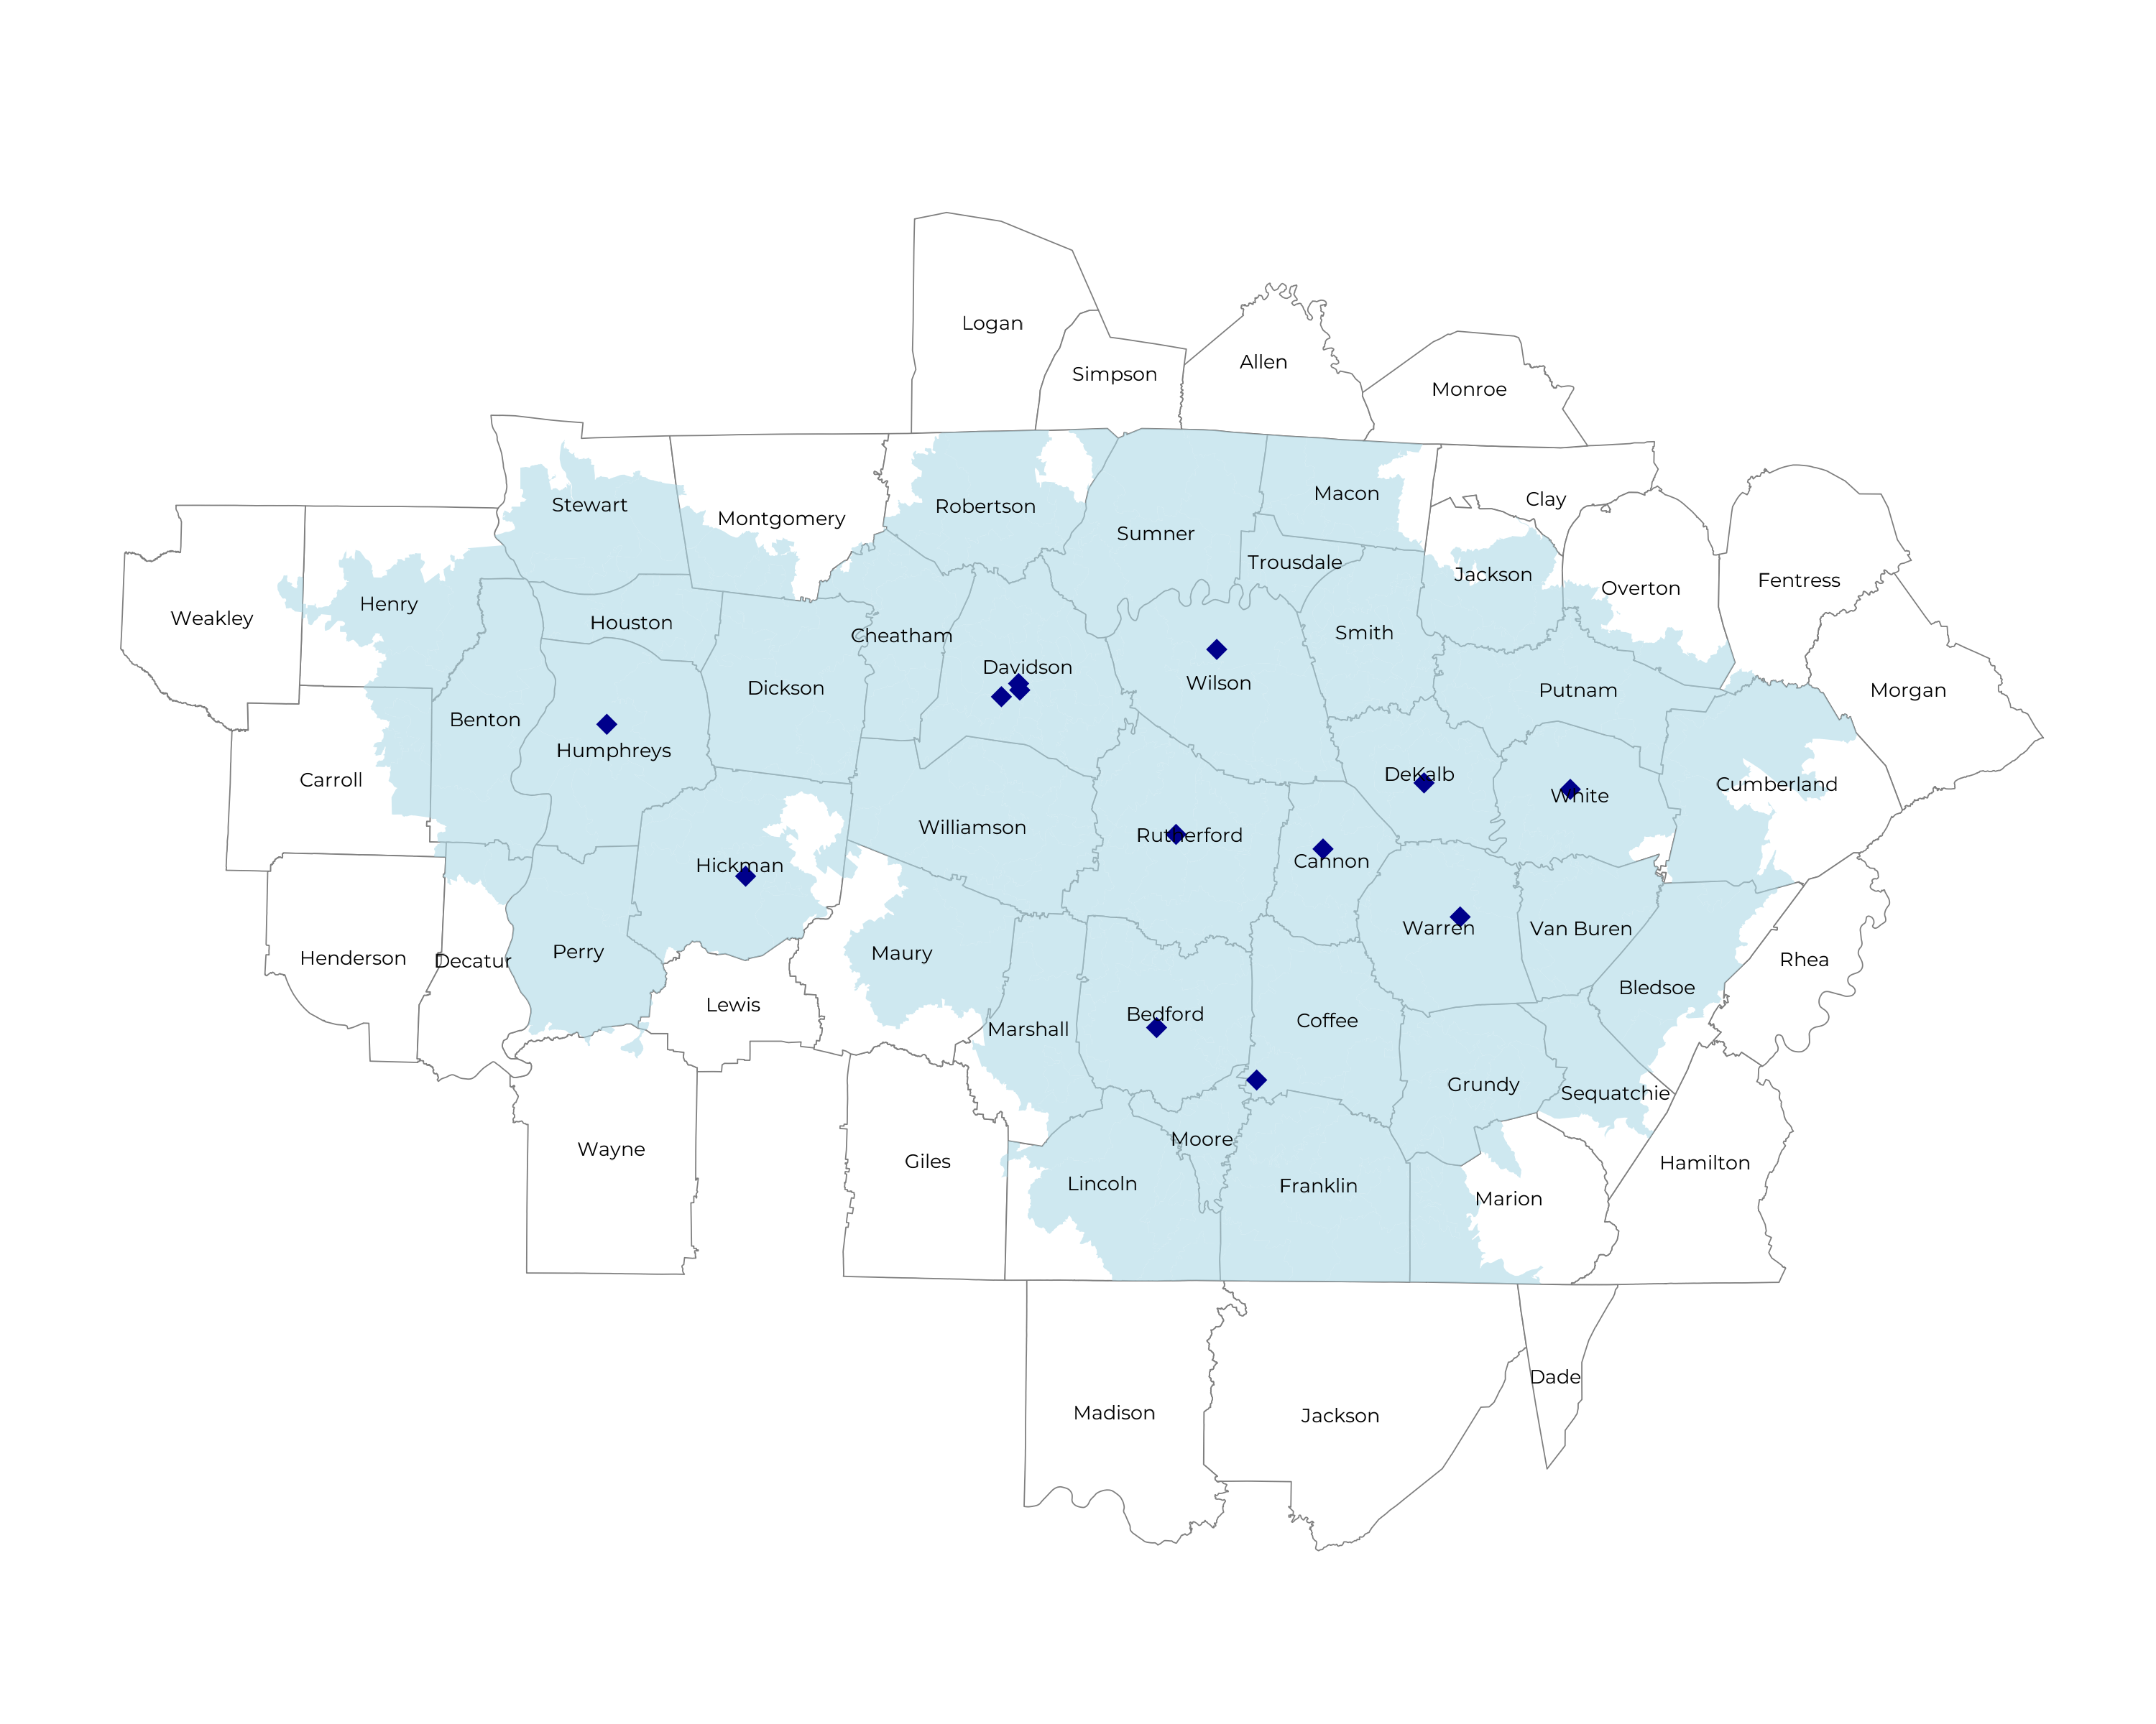
MEASURING PARTNERED MARKET SIZE
Self Funded
592K
Insured
1,076K
Working Age
1,498K
Population
2,470K
Partnered market size is larger than standalone as Vanderbilt increases plan reach.

Slide 28
STRONGE PROJECTED PLAN GROWTH
Year | Employees | Members | Percent of Members Choosing Ascension Health TN for Inpatient Care | Percent of Members Choosing Ascension Health TN for Outpatient Care
1 | 2,400 | 4,300 | 30% | 30%
2 | 4,900 | 8,800 | 30% | 30%
3 | 8,000 | 14,400 | 30% | 28%
4 | 12,000 | 21,600 | 30% | 28%
5 | 17,100 | 30,800 | 30% | 28%
6 | 23,400 | 42,100 | 30% | 28%
7 | 31,000 | 55,800 | 30% | 28%
8 | 39,800 | 71,600 | 30% | 28%
9 | 49,800 | 89,600 | 30% | 27%
10 | 60,600 | 109,100 | 30% | 27%
11 | 71,700 | 129,100 | 30% | 27%
12 | 82,600 | 148,700 | 30% | 27%
13 | 92,700 | 166,900 | 30% | 27%
14 | 101,700 | 183,100 | 30% | 27%
15 | 109,400 | 196,900 | 30% | 27%
16 | 115,700 | 208,300 | 30% | 27%
17 | 120,600 | 217,100 | 30% | 27%
18 | 124,500 | 224,100 | 30% | 27%
19 | 127,400 | 229,300 | 30% | 27%
20 | 129,600 | 233,300 | 30% | 27%
KBA currently estimates that Ascension Health TN has 18% inpatient market share, and 7% outpatient market compared to hospitals/clinics in the Ascension Health TN service area.
KBA conservatively models steerage growth based on past DTE-plan experience, assuming Ascension receives 38% of steered care.
Plan growth is far stronger in a partnered health plan.

Slide 29
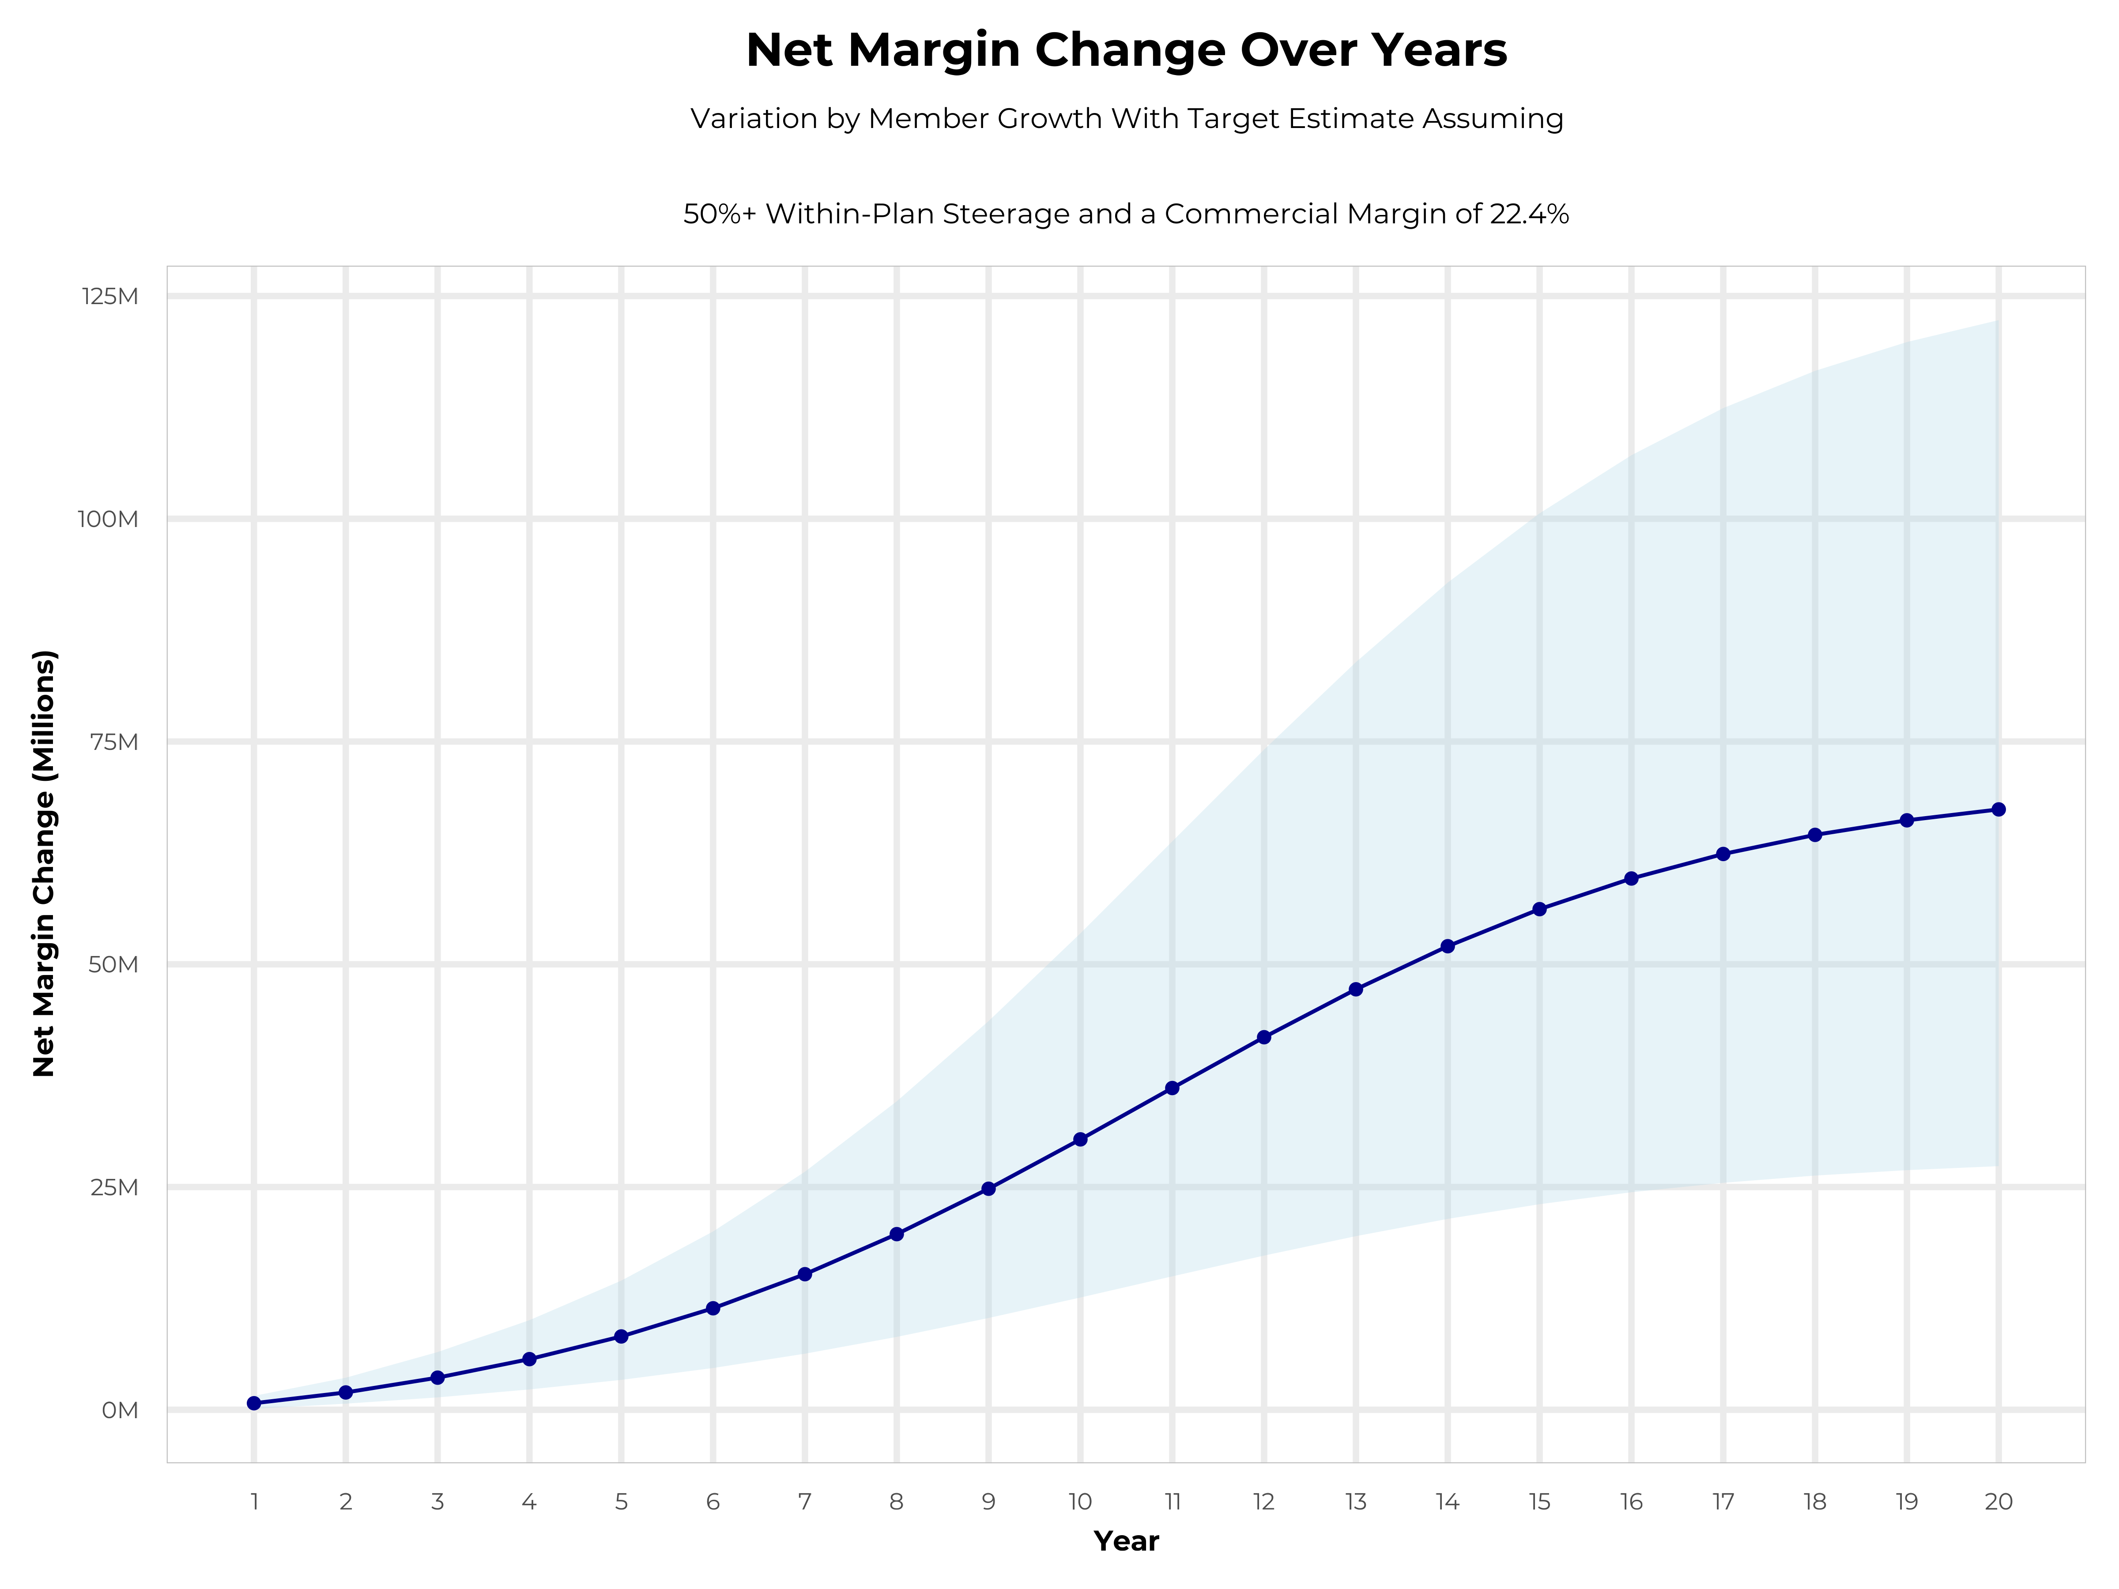
SIMILAR PROFTIABILITY TO A STAND-ALONE PLAN
Early Stage
Gaining Name Recognition, Early Growth
New Revenue:
New Profit:
$24.04M
$5.26M
Growth Stage
Strong Reputation, Strong Growth
New Revenue:
New Profit:
$136.01M
$30.74M
Mature Stage
High Profitability, Market Saturation
New Revenue:
New Profit:
$270M
$61.18M

